Slide 1
Emotion Recognition
Roger Carl
Tianqi Liu
Hanzhang Zeng

Slide 2
Recall
Two weeks ago we decided
Implementing classifier for four emotions
Neutral
Happy
Sadness
Anger
Cohn-Kanade database
Eigenface detector vs Fisherface detector
Eigenface: Using Principal component analysis, project vectors to a lower dimension. Good at tracking peak points on faces. Noise prone.
Fisherface: Using Linear discriminant analysis, regression-liked analysis between different class of data. Good at overall face detection. Heavy Computation.

Slide 3
Components
Our emotion recognizer composes of two parts:
Facial Extraction
Emotion Recognition
Following our plan on week 10:
Implemented the emotion recogniser based on Fisherface recogniser
Result was unsatisfying
The happy emotion can barely be detected
The Fisherface takes a whole face region into account, which leads to the high inaccuracy in classification
The face extraction sometime loses track of face components

Slide 4
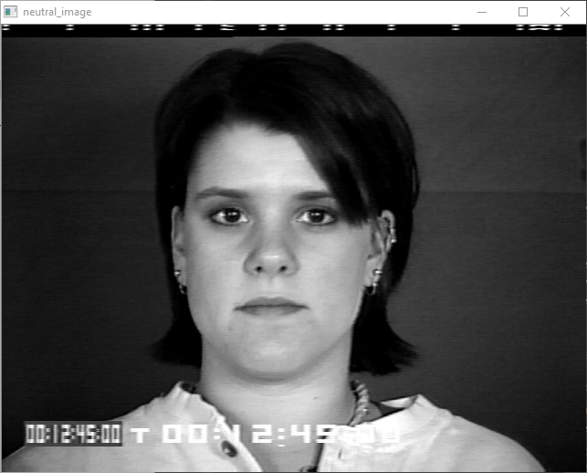
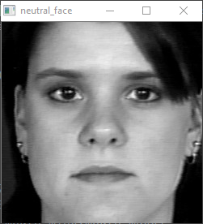
The old method for face extractor

Slide 5
Improved face extractor
We decided to extract the face based on:
Eyes
Mouth
When we change emotion, which leads a significant change on eyes and mouth. (i.e. When we smile, our mouth goes up and opens. When we get angry, our eyes form specific angle and our mouth close.)
According to these features, we decide to crop the eyes and mouth and combine them together into one image.

Slide 6
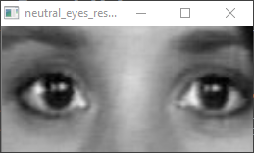
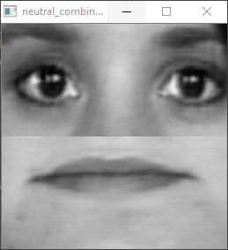
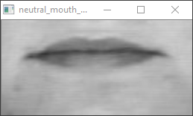
Improved face extractor

Slide 7
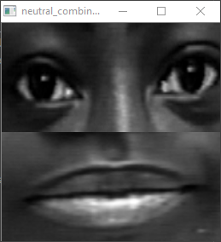
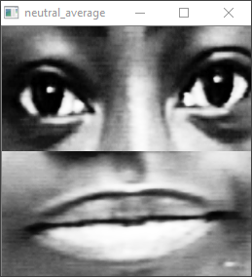
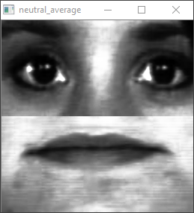
Skin colour averaging
Further more, we use histogram equalisation to smooth the skin colour difference.

Slide 8
Eigenface vs Fisherface
We tested our dataset on both Fisherface and Eigenface.
The Eigenface approach provides better results because:
Eigenface is better for feature points detection
With only the eyes and mouth, we have much more feature points compacted on a single image
The Fisherface approach yields slightly poor result:
Fisherface does overeall detection
We believe it takes extra considerations on points that we are not specifically interested in.

Slide 9
Software Improvement
To extend the eye extractor for better accuracy:
Extend eyes region to capture the eye brows
Estimate eyes region when Haar-cascade does not work
Mouth tracking:
When Haar-cascade does not detect mouth in video frames
Estimate mouth x axis based on the centre of eyes
Estimate mouth y axis with the height of lower half image

Slide 10
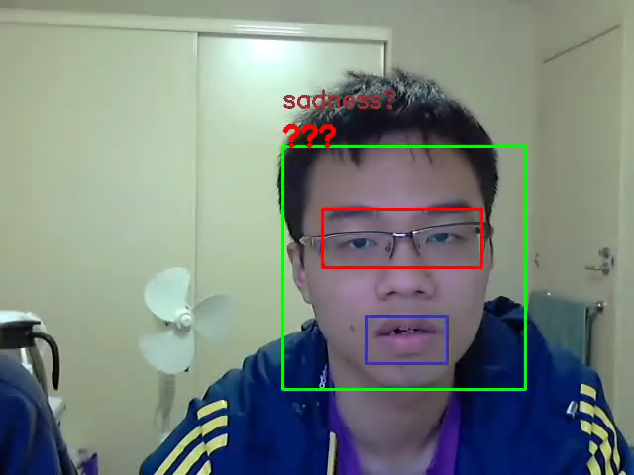
Video Demo

Slide 11
Evaluation
We wrote a snippet of python code to test the prediction on static images before actually implementing the live stream testing code.
The accuracy estimation on Cohn-Kanade library is around 60 to 70 percent.
On live stream testing, we evaluate based on out our eye because it is not really possible to test the emotion when it’s changing rapidly, wee basically count the number of expression predicted correct in a given time range and divide by the total number of expression made. The accuracy is about 30 to 40 percent.

Slide 12
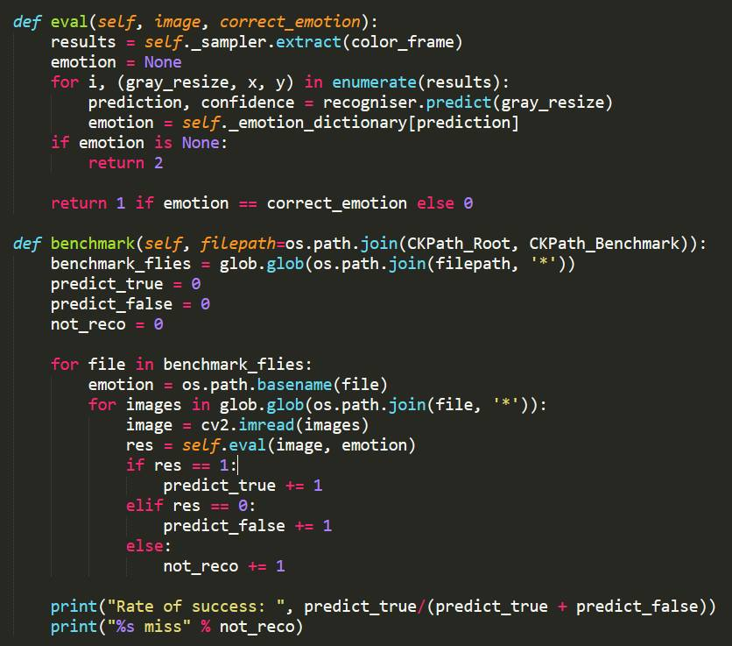
illimitation

Slide 13
Limitations
The live capture is limited to illimitation and background.
Noise largely affects accuracy of prediction for Eigenface
Large contrast in illumination would create unwanted feature points
Same with background, it is best to use blank backgrounds with no contrasts
Also the quality of the image affects the final result
When taking live image, the user can be in any position and the facial expression can vary greatly unlike a well organized database
The quality of image taken from the laptop is no where near the quality from the database
These factors greatly determine the result of the prediction sometimes leave the program unusable.

